Slide 1



‘25
St. JOSEPH’S
COLLEGE OF ENGINEERING
(An Autonomous Instituion)
SPRINTATHON’25
A SPRINT TO REVOLUTION
1
Problem Statement Number- PSA601
2
Problem Statement – Crop and Soil Management System.
3
Domain - Software
4
Team Name- Innotech
5
Team Members Name – THARUNYA ST, JANANI S, BAHARANIDHARAN, SHARVESWAR S
6
College Name – BANNARI AMMAN INSTITUTE OF TECHNOLOGY

Slide 2
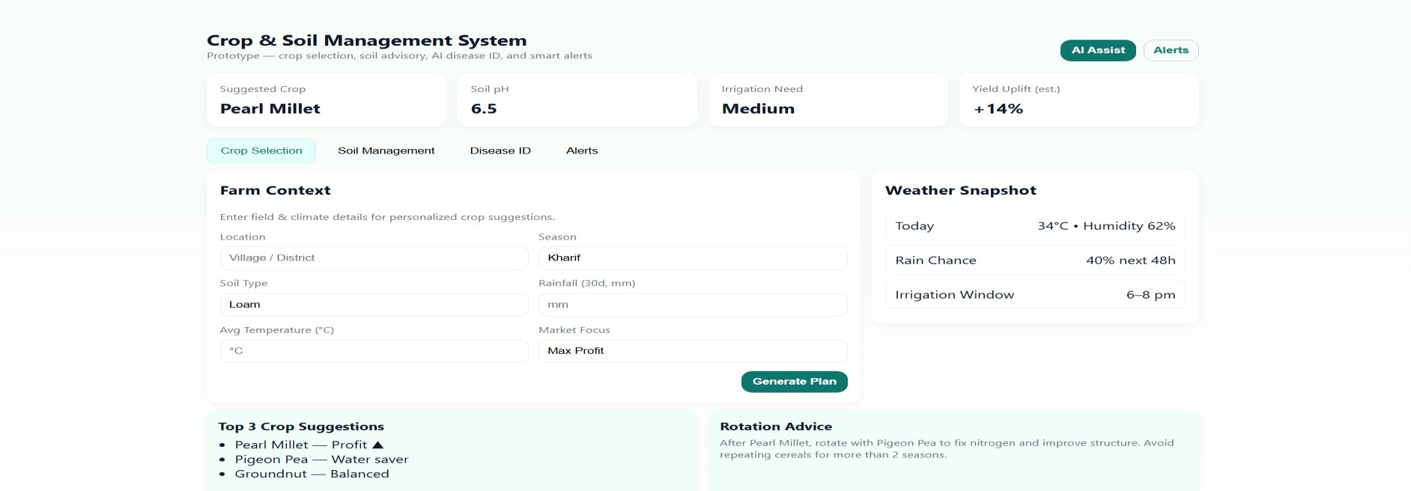
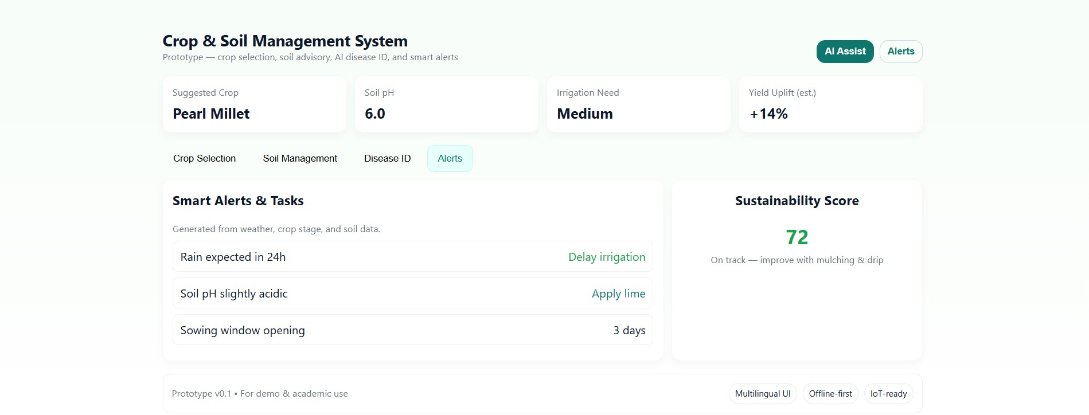
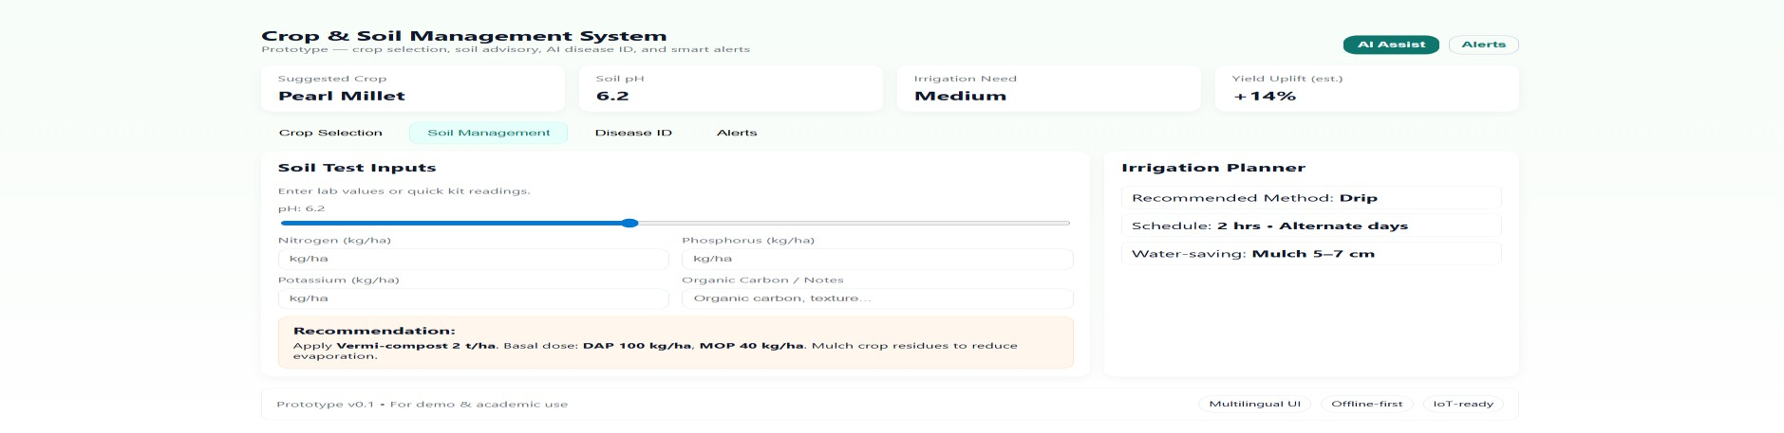
‘25
St. JOSEPH’S
COLLEGE OF ENGINEERING
(An Autonomous Instituion)
Problem Summary
Many farmers struggle to choose the right crops, manage soil health, and detect diseases early. Without access to scientific advice, they often rely on traditional methods. This leads to low crop yields, overuse of fertilizers, soil damage, and high costs. Late detection of pests and diseases causes major crop losses. The lack of real-time, personalized support makes farming less efficient and unsustainable.
PROTOTYPE
Solution
Crop Recommendation – Uses Decision Tree/Random Forest to
suggest best crops from soil, weather & market data.
Soil Advisor – Regression & Fuzzy Logic analyze pH, NPK, moisture for fertilizer advice.
Disease Detection – TensorFlow +CNN models classify leaf images
to detect pests/diseases & suggest remedies.
Dashboard & Alerts – Predictive Analytics provide weather, irrigation & disease alerts.

Slide 3
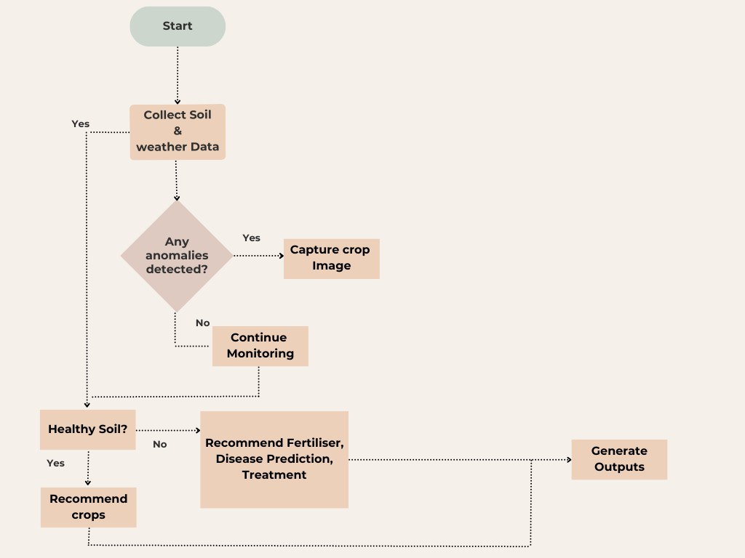










‘25
St. JOSEPH’S
COLLEGE OF ENGINEERING
FLOWCHART
(An Autonomous Instituion)
TECHNICAL STACK
Frontend
Backend
scikit
Database
Firebase

Slide 4
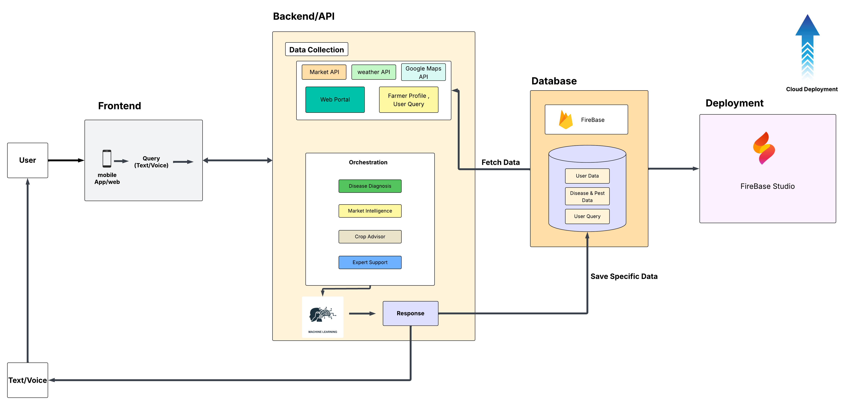
ARCHITECTURE

Slide 5
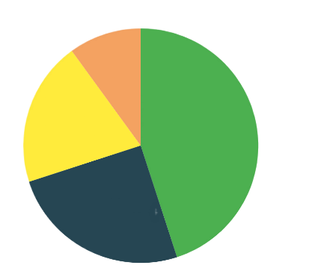

‘25
St. JOSEPH’S
COLLEGE OF ENGINEERING
(An Autonomous Instituion)
TARGET AUDIENCE
Small & Marginal Farmers 45%
Government Agricultural Departments
Researchers and students 25%
Small & Marginal Farmers
Researchers and students
Government Agricultural Departments 20%
Agricultural Cooperatives & Groups 10%

Slide 6
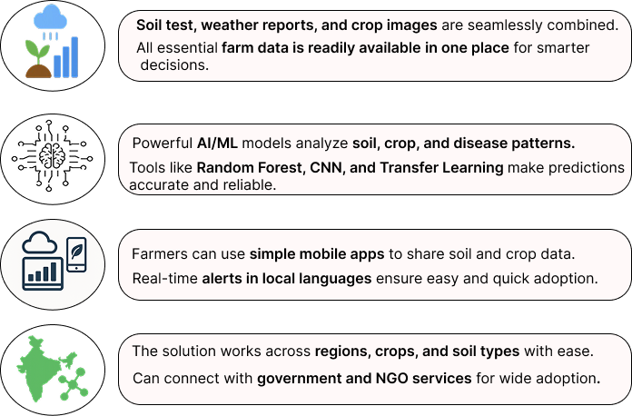
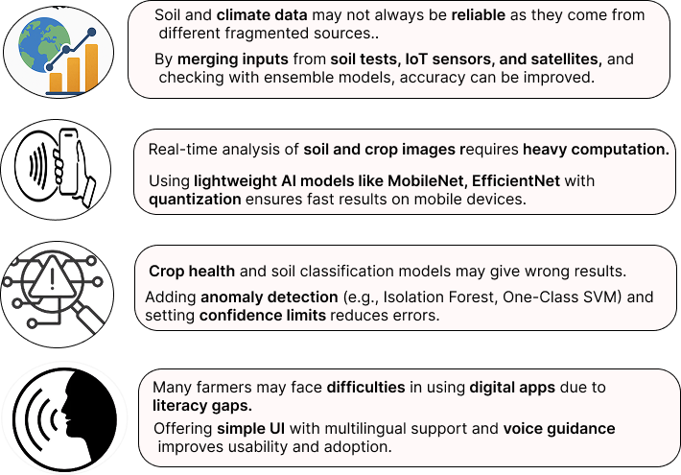
‘25
St. JOSEPH’S
COLLEGE OF ENGINEERING
(An Autonomous Instituion)
FEASIBILITY
VIABILITY

Slide 7
‘25
St. JOSEPH’S
COLLEGE OF ENGINEERING
(An Autonomous Instituion)
MARKET DEMAND ANALYSIS
Growing Need for Smart Agriculture – With rising population and food demand, farmers require data-driven tools to maximize yield and efficiency.
Farmer Challenges – Many farmers struggle with wrong crop choices, poor soil management, and late disease detection, creating strong demand for AI-based solutions.
Digital Adoption in Rural Areas – Increasing smartphone and internet penetration in villages
makes mobile-based farming apps more accessible.
Government & NGO Support – Policies promoting precision farming, soil health monitoring, and sustainable agriculture encourage adoption of such systems.
Market Potential – Agriculture technology (Agri Tech) is a rapidly growing sector, with farmers,
cooperatives, and agri-businesses actively seeking innovative solutions.
Sustainability Focus – There is high demand for eco-friendly solutions that reduce chemical use, conserve water, and maintain soil fertility.

Slide 8
‘25
St. JOSEPH’S
COLLEGE OF ENGINEERING
(An Autonomous Instituion)
RESEARCH AND REFERENCES
https://ieeexplore.ieee.org/document/10205756/
https://link.springer.com/article/10.1007/s44230-024-00081-3
https://www.researchgate.net/publication/327065422_Plant_Disease_Detection_Using_Machine_Learning
https://bsppjournals.onlinelibrary.wiley.com/doi/10.1111/ppa.14006
https://arccjournals.com/journal/agricultural-science-digest/D-5893
https://www.sciencedirect.com/science/article/abs/pii/S0048969723053548
https://www.ijnrd.org/papers/IJNRD2303270.pdf

